Slide 1
Customer segmentation using dbscan algorithm
Unlocking business growth
TEAM MEMBERS
P.Prameela - (S180048) UNDER THE GUIDANCE OF
J.Sujay - (S180626) MR. T NARASIMHAPPADU
P.Kumari - (S180192)

Slide 2
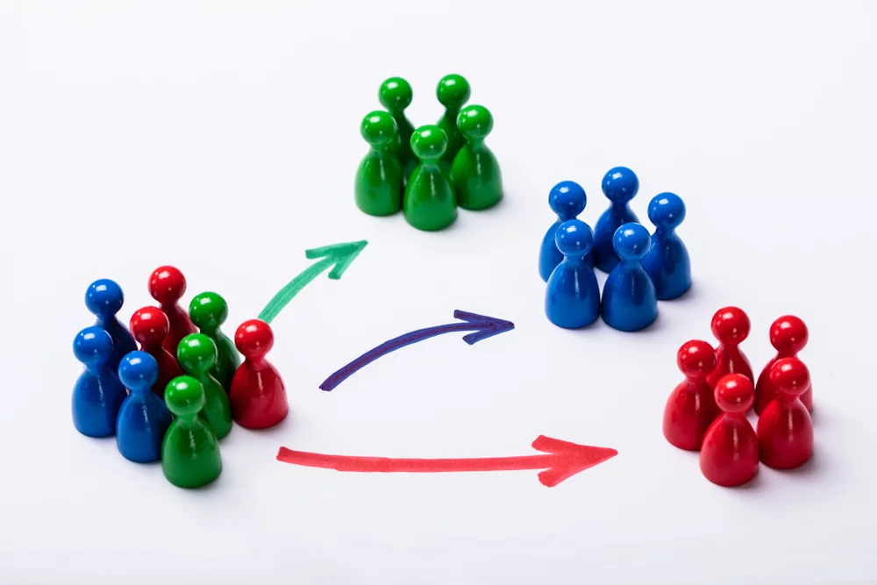
AGENDA
Problem Statement
Abstract
Introduction
Existing and Proposed Systems
EDA & Pre-processing
Working of DBSCAN Algorithm
Results and Analysis
Advantages of Customer Segmentation
Conclusion
References

Slide 3
Problem statement
In today's highly competitive business landscape, understanding customers and delivering personalized experiences is critical for success. One key challenge faced by businesses is effectively segmenting their customer base to tailor marketing campaigns and strategies for maximum impact. The solution to this problem would enable businesses to gain deep insights into customer segments, understand their unique characteristics and preferences, and design targeted marketing strategies.

Slide 4
Abstract
This project aims to perform customer segmentation based on the products they have bought and their shopping behavior in a mall. The objective of this project is to identify distinct customer groups and understand their characteristics to develop targeted marketing strategies and increase business income. Applying DBSCAN algorithm as one of the density based algorithms results in a meaningful customer segmentation. It aims to create a relationship with the most profitable customers by designing the most appropriate marketing strategy. The results obtained from this project can help the mall to personalize marketing efforts and optimize promotional campaigns to target specific customer groups effectively. In addition, this project proposes to offer personalized incentives, the mall aims to increase customer loyalty, attract new customers, and ultimately increase revenue.

Slide 5
Introduction
Customer segmentation is a vital strategy that businesses use to divide their customer base into distinct groups or segments.
By grouping customers with similar characteristics together, businesses can better understand their customers and tailor their marketing efforts to meet their unique needs and preferences.
The primary goal of customer segmentation is to gain insights into different customer groups and develop targeted marketing strategies.

Slide 6
Existing system
One of the most common and widely used systems for customer segmentation is RFM (Recency, Frequency, Monetary) analysis.
This method segments customers based on three key metrics: how recently they have made a purchase (Recency), how frequently they make purchases (Frequency), and how much money they spend (Monetary).
By analysing these three factors, businesses can identify their most valuable customers and tailor their marketing strategies to suit their needs.

Slide 7
Proposed system
The proposed system for customer segmentation is the use of Machine Learning algorithms to analyse customer data and identify patterns that might not be immediately apparent using traditional methods.
For example, a business might use clustering algorithms to group customers based on their purchasing behaviour and other data points. The data points are grouped into clusters based on the density of the points will help the company understand how the customers differ.
By offering personalized incentives, the company aims to increase customer loyalty, attract new customers, and ultimately increase revenue.

Slide 8
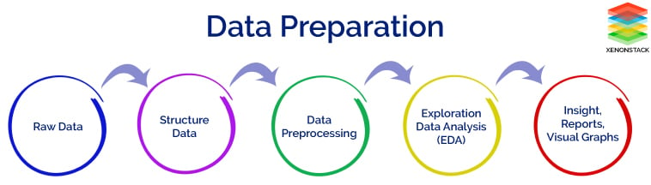
EDA & data pre-processing
We have utilized a dataset that is of no missing values.
We have employed a range of visualization techniques to identify the interrelationships between the various attributes.
This will enable us to cluster the data more efficiently and ultimately facilitate more effective segmentation.

Slide 9
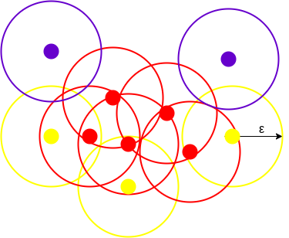
Working of DBSCAN Algorithm
DBSCAN stands for Density-Based Spatial Clustering of Applications with Noise. It groups ‘densely grouped’ data points into a single cluster.
It can identify clusters in large spatial datasets by looking at the local density of the data points. The most exciting feature of DBSCAN clustering is that it is robust to outliers.
Epsilon (ε) - A distance measure that will be used to locate the points/to check the density in the neighborhood of any point.
Minpoints (n) - The minimum number of points (a threshold) clustered together for a region to be considered dense.

Slide 10
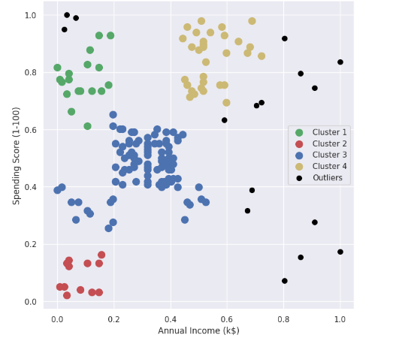
Results and analysis
The figure shows the results of using the DBSCAN algorithm to segment customers based on their Spending score and Annual income. Four distinct clusters were identified, each representing a different customer segment. Outliers are also displayed separately. Annual income (k$) is taken on x-axis and Spending Score (1-100) on y-axis

Slide 11
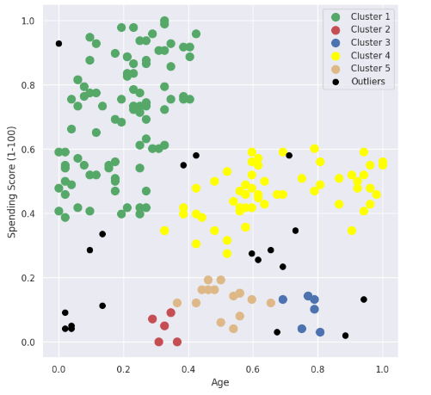
Results and analysis
The figure shows the results of using the DBSCAN algorithm to segment customers based on their Spending score and Age. Five distinct clusters were identified, each representing a different customer segment. Outliers are also displayed separately. Age is taken on x-axis and Spending Score (1-100) on y-axis

Slide 12

Advantages of customer segmentation
Enhanced Customer Satisfaction
Competitive Advantage
Customer Retention and Loyalty
Improved Customer Understanding
Targeted Product Development

Slide 13

Conclusion
It’s not wise to serve all customers with the same product model, email, text message campaign, or ad. Customers have different needs. A one-size-for-all approach to business will generally result in less engagement, lower-click through rates, and ultimately fewer sales. Customer segmentation is the cure for this problem. Customer segmentation is well-liked because it makes marketing and sales more effective. This is so that you can have a better grasp on what your customers’ desires and needs are. This has even greater ﬁnancial implications, and using efﬁcient customer segmentation will help you raise client lifetime value. This implies that they will spend more money and stay longer. You can make customers more loyal by getting to know them better so you can target them better.

Slide 14
References
Customer Segmentation Techniques on E-Commerce
- Sumit Koul, Trissa Merrin Philip
A Cluster-based Analysis for Targeting Potential Customers in Real-world Marketing System
- Sheikh Sharfuddin Mim, Doina Logofatu
Maximizing Strategy in Customer Segmentation Using Different Clustering Techniques
- Pavithra M, Ayushman Prashar, Abirami

Slide 15


